Slide 1
Lecture Objectives
Round two of these concepts with examples:
Compiling and linking using g++ (Recap)
Running your program and PATH
Zip and Tarballs
Transferring files with WinSCP
Shell Scripts
Parsing the command line
Calling the Shell

Slide 2
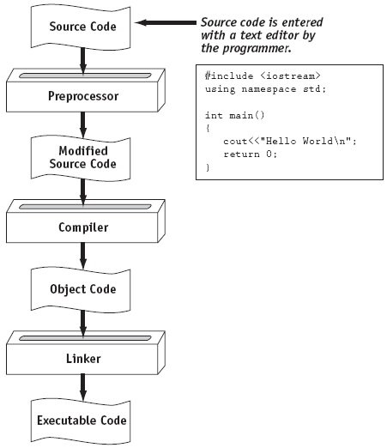
From a High-Level Program to an Executable File

Slide 3
From a High-Level Program to an Executable File
Create file containing the program with a text editor.
Run preprocessor to convert source file directives to source code program statements.
Run compiler to convert source program into machine instructions.
Run linker to connect hardware-specific code to machine instructions, producing an executable file.
Steps b–d are often performed by a single command (g++ with no options).
Errors detected at any step will prevent execution of following steps.

Slide 4
GNU Compiler
Users invoke a language-specific driver program (gcc for C, g++ for C++, etc.)
Usage: g++ <file.cc>
This compiles and links the code and creates an executable called a.out. This calls steps b-d together as in previous slide.
More Info:
http://en.wikipedia.org/wiki/GNU_Compiler_Collection

Slide 5
GNU Compiler
From the g++ man page:
file.h
C, C++, Objective-C or Objective-C++ header file to be turned into a precompiled header.
file.cc, file.cp, file.cxx, file.cpp, file.CPP, file.c++, file.C
C++ source code which must be preprocessed. Note that in .cxx, the last two letters must both be literally x. Likewise, .C refers to a literal capital C.

Slide 6
GNU Compiler
From the g++ man page:
-E
Stop after the preprocessing stage; do not run the compiler proper. The output is in the form of preprocessed source code, which is sent to the standard output.
-c
Compile or assemble the source files, but do not link. The linking stage simply is not done. The ultimate output is in the form of an object file for each source file. By default, the object file name for a source file is made by replacing the suffix .c, .i, .s, etc., with .o.
-o
C++ source code which must be preprocessed. Note that in .cxx, the last two letters must both be literally x. Likewise, .C refers to a literal capital C.

Slide 7
From a High-Level Program to an Executable File
-E option
-c option
-S for assembler output
if no –E, -c ,-S given
<- a.out (or whatever you name it with –o)

Slide 8
Running your program
If you program compiles successfully, it will be named:
a.out (if you did not use –o flag)
Whatever you choose if you do use –o flag
To run the program, you must ensure 2 things:
You call the correct name
You find it in the path (add ./ to beginning)

Slide 9
tarballs
From a Google search:
Tarball is a jargon term for a tar archive - a group of files collected together as one.
Tarballs are the standard, and are common with file extensions such as ".tar.gz" or ".tar.bz2". This is the generic, distribution-free method of distribution software packages in the Linux world.
tarballs are like .zip files in Windows (and .zip exists on Linux). However, it allows splitting of the archive from the compression.

Slide 10
tarballs
To use tar:
Change directory so that you can see the folder you want to turn into a tarball.
Issue this command:
tar cfvz Program1.tar.gz Program1
The “Program1.tar.gz” is your output file
The “Program1” (second arg) is the source folder

Slide 11
tarballs cont
From the tar man page:
-c, --create
create a new archive
-f, --file=ARCHIVE
use archive file or device ARCHIVE
-v, --verbose
verbosely list files processed
-z, --gzip
filter the archive through gzip

Slide 12
tarballs cont
From the tar man page:
-c, --create
create a new archive
-f, --file=ARCHIVE
use archive file or device ARCHIVE
-v, --verbose
verbosely list files processed
-z, --gzip
filter the archive through gzip

Slide 13
tarballs cont
These are all the same:
tar cfvz Program1.tar.gz Program1
tar -c -f Program1.tar.gz -v -z Program1
tar --create --file=Program1.tar.gz --verbose --gzip Program1

Slide 14
tarballs on Windows
If you wish to view tarballs on Windows, you must have a program that understand their format. I recommend a free package called 7-zip. You can download and install here:
http://www.7-zip.org/
Once installed, you can right click on a .tar or .tar.gz file in Windows and extract the contents.

Slide 15
Secure Copy
How to get files from a unix system to another system (Unix or Windows)? Use a secure copy program (sftp or scp).
From the scp man page:
scp copies files between hosts on a network. It uses ssh(1) for data transfer, and uses the same authentication and provides the same security as ssh(1).
For windows systems, I recommend a free program called WinSCP:
http://winscp.net
Particularly useful for transferring tarballs between Windows and UNIX

Slide 16
Shell Scripts
What is a shell script? From Wikipedia:
A shell script is a computer program designed to be run by the Unix shell, a command line interpreter. The various dialects of shell scripts are considered to be scripting languages. Typical operations performed by shell scripts include file manipulation, program execution, and printing text.
All recommended UNIX EBooks have sections devoted to shell scripts. See: Linux Essentials: Chap 12
It is a file that has these characteristics:
It has the executable bit set so that the shell can execute it (not strictly necessary)
It has a Shebang as its first line:
#!<path to interpreter>
Ex: #!/bin/bash
The rest of the file contents are commands for the selected interpreter

Slide 17
Shell Scripts cont
Example Shell Script file:
#!/bin/bash
# The file will be interpreted by the Bash shell
# Anything starting with the # symbol is a comment
ls –al
ls –al > directory.output.txt

Slide 18
To Execute Shell Scripts
Set the executable bit:
chmod o+x compile.sh (see man chmod)
Executes the shell script:
./compile.sh
As with executing C++ programs, the
./
forces shell to look in the current directory. Only necessary if the PATH variable does not include the current directory.
Alternately, you can call the interpreter directly:
/bin/bash ./cmpile.sh

Slide 19
C++ and args to main()
When g++ compiles a program, it looks for an entry point called main(). As you are aware, C++ requires the main() procedure and this is where your program starts.
The C++ main routine has this prototype:
int main(void);
int main();
int main(int argc, char **argv);
int main(int argc, char *argv[]); <- My preferred

Slide 20
C++ and args to main() Cont
argc - An integer that represents the number of arguments that were passed into your program
argv – a pointer to an array of strings. Each element in the array is a separate string that represents the value passed in. Arrays start at index 0.

Slide 21
C++ and args to main() cont
When your program executes, the shell is called to execute your program and your program’s path and name are passed as the first argument.
So… argc will ALWAYS be at least 1.
So… argv[0] will ALWAYS be the path and the name of your program.
Example

Slide 22
The system() command
From the sytem man page:
SYNOPSIS
#include <stdlib.h>
int system(const char *command);
DESCRIPTION
system() executes a command specified in command by calling /bin/sh -c command, and returns after the command has been completed.
(Note: Check out the man page for sh to determine what the –c flag does)

Slide 23
The system() command example
#include <stdlib.h>
using namespace std;
int main(void)
{
system("ls -al");
}

